Slide 1
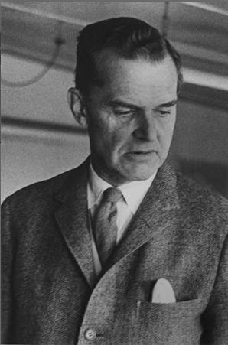
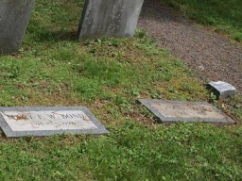
About James Bond (The Ornithologist)
Born in the suburbs of Philadelphia in 1900
Mother died while young
Family moved to England in time for WWI
Came back to Phila, in the early ‘20s to study banking
Began a relationship with the Academy Of Natural Sciences pertaining to ornithology
In trips to Jamaica discovered the true relationship of bird formation in the Americas
Discovered what is called the James Bond line of demarkation
Wrote “Birds of the West Indies” in 1936, reissued in 1948 and 1960
Theoretically this book and the book’s author’s name was used by Ian Fleming to name his character.

